Slide 1
TDD
Giuseppe Scanniello
Simone Romano
Michelangelo Esposito

Slide 2
Traditional development
Requirements Specification
The waterfall development lifecycle model has been widely adopted in the past
Preliminary Design
Detailed Design
Coding
Unit Testing
Integration Testing
System Testing

Slide 3
Traditional development
Requirements Specification
Weaknesses?
There is a very long feedback cycle between requirements specification and system testing, in which the customer is absent
Preliminary Design
Detailed Design
Coding
Unit Testing
Integration Testing
System Testing

Slide 4
Traditional development
Requirements Specification
Weaknesses?
No working software is delivered before the end of the process
Preliminary Design
Detailed Design
Coding
Unit Testing
Integration Testing
System Testing

Slide 5
Traditional development
Requirements Specification
Weaknesses?
Any fault or omission at the requirements level will penetrate through the remaining phases
Preliminary Design
Detailed Design
Coding
Unit Testing
Integration Testing
System Testing

Slide 6
A way to overcome the limitations of traditional development?
Agile Development

Slide 7
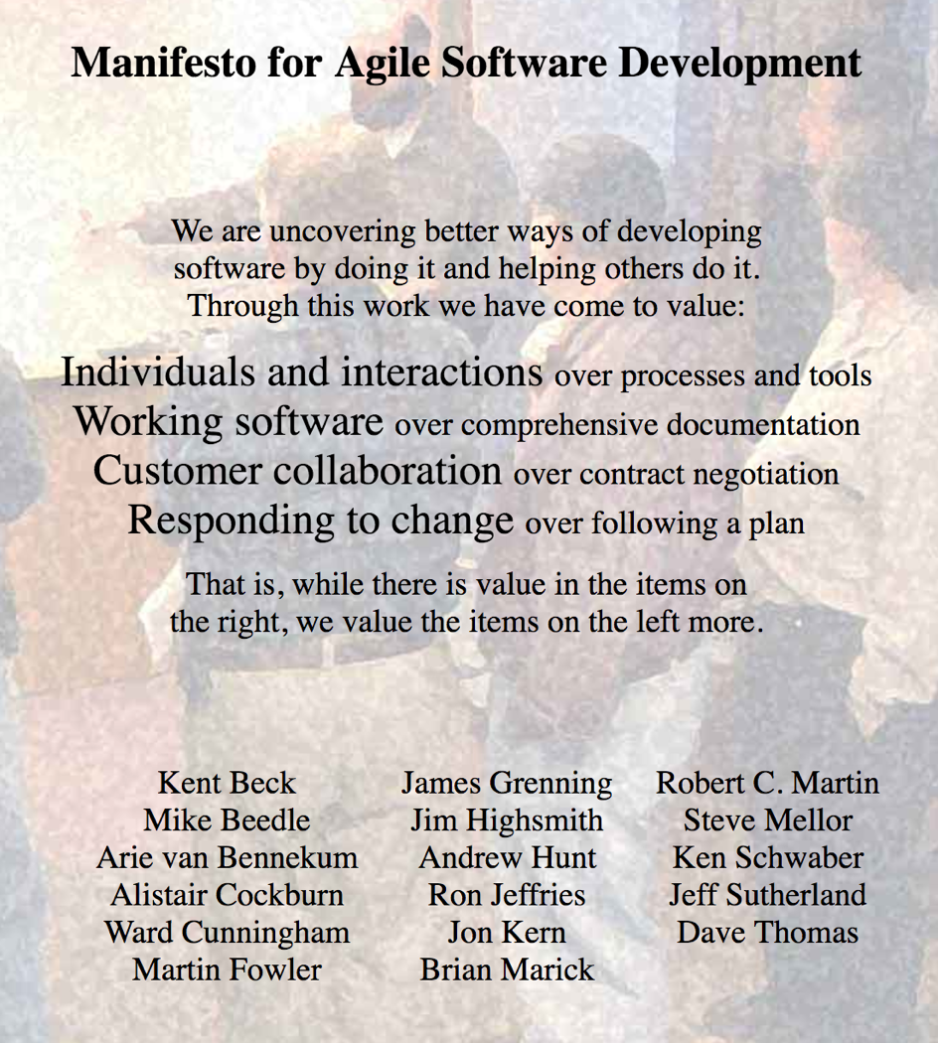
Agile development
Based on the values and principles derived from the Agile Manifesto
There are several variants of agile software development (some websites list up to 40 variants)
Extreme programming (XP)
Test-driven development (TDD)
Feature-driven development (FDD)
Scrum
…

Slide 8
Agile development
A time boxed, iterative approach to software development in which software systems are built and delivered incrementally from the beginning of the project, rather than trying to deliver it all at once near the end
It works by breaking down the software systems' functionality into little bits called user stories, prioritizing them, and continuously delivering them in short cycles called iterations

Slide 9
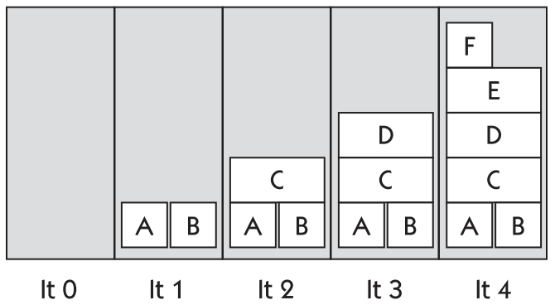
Testing in agile development
Each increment of coding is tested as soon as it is finished
A story is not "done" until it has been tested and the tests have passed
User stories
Iteration

Slide 10

TDD
It has been proposed (or popularized) by Kent Beck in his 2002 book Test-Driven Development by Example
An approach to software development in which developers interleave testing, development, and refactoring
Developers (not testers) first write automated unit tests and then the associated production code

Slide 11
TDD
It is an extreme case of agility
Developers focus on smaller increments of coding that they perform in shorter iterations (at most 10-15 minute long) w.r.t. to other software development variants
TDD is also used within other agile development variants like XP or Scrum

Slide 12
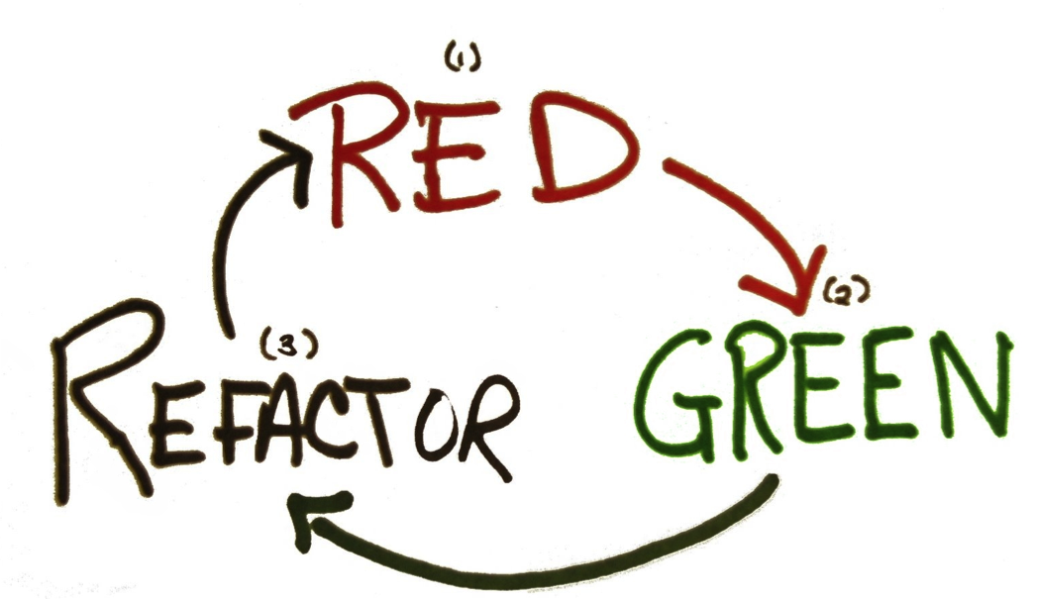
TDD mantra
Very short cycles of three phases:
1. Red
2. Green
3. Refactor
A cycle should last at most 10-15 minutes (less is even better)

Slide 13
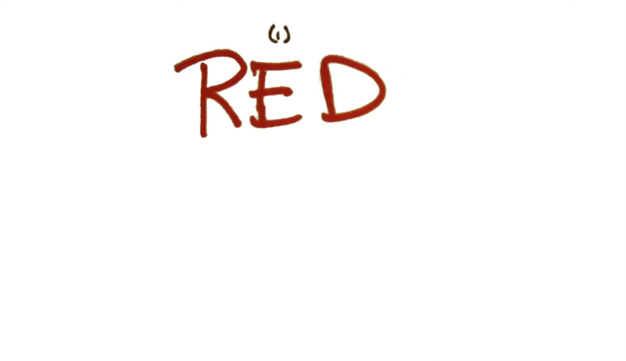
Red phase
Write a failing unit test for a small chunk of functionality, which is not implemented yet
Perhaps the test does not even compile at first
Run the test
Watch the test fail

Slide 14

Green phase
Make the unit test pass quickly (i.e., write the minimal amount of code to make the test pass), committing whatever sin necessarily in the process
Run the test (as well as any other test)
Watch the test pass (as well as any other test)

Slide 15
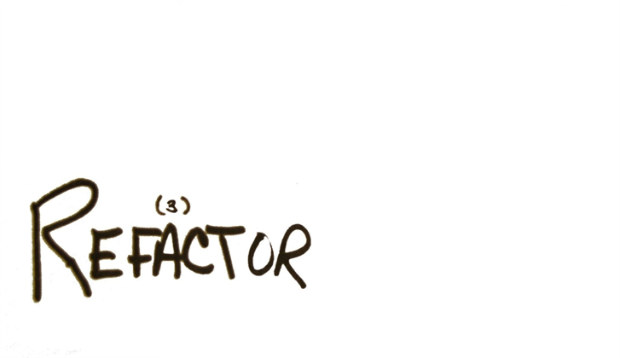
Refactor phase
Eliminate all duplications and smells created in just getting the test to pass
Run all tests
Watch them pass

Slide 16
Best practice
Make it green, then make it clean!
It is similar to a game, where your goal is to play with a unit test until it becomes green

Slide 17
The three laws of TDD
TDD practitioners follow three laws [Martin 2007]:
You may not write production code unless you have first written a failing unit test
You may not write more of a unit test than is sufficient to fail
You may not write more production code than is sufficient to make the failing unit test pass

Slide 18
Fundamental principles
Think about what you are trying to do
Follow the TDD mantra, the best practice, and the three laws
Continually make small, incremental changes
Keep the system running at all times---failures must be addressed immediately

Slide 19
TDD can be seen as…
baby steps + | test-first sequencing | + refactoring
Focus on small chunks of functionality supposed to be implemented in few minutes
Write the tests before the associated production code
Improve the design of the written code

Slide 20

Do I need guidelines for writing unit tests in the TDD contest?
Sure, you should already know them!!!

Slide 21
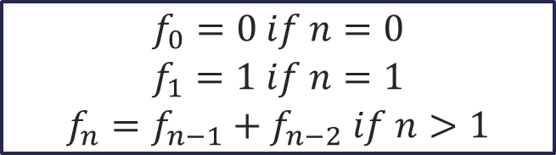
TDD in action
Let us apply TDD to the Fibonacci numbers example
For simplicity, we will not consider invalid input values

Slide 22
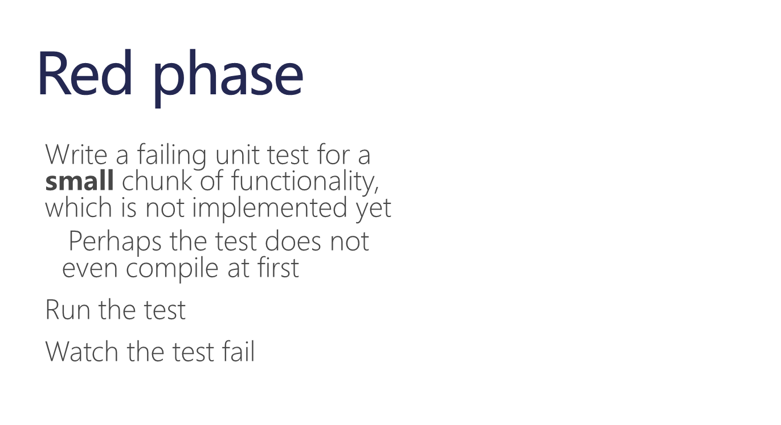
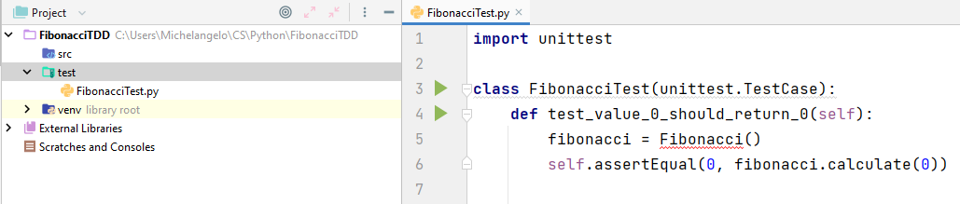
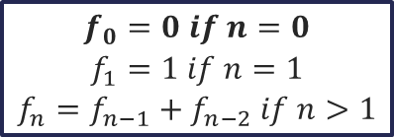
TDD in action – cycle #1
Chunk of functionality #1

Slide 23
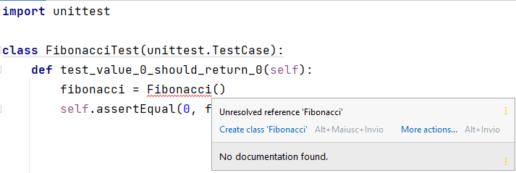
TDD in action – cycle #1
Make it compile---create the class Fibonacci

Slide 24
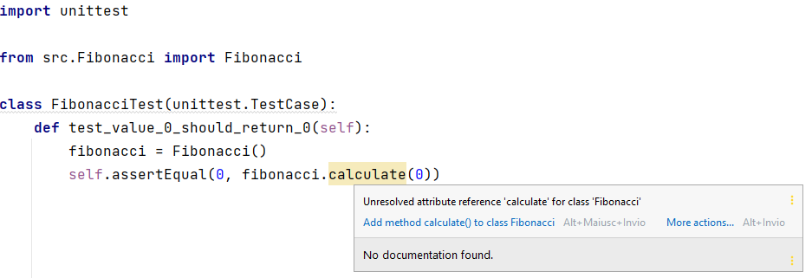
TDD in action – cycle #1
Make it compile---create the method calculate(int)

Slide 25


TDD in action – cycle #1
It fails!

Slide 26
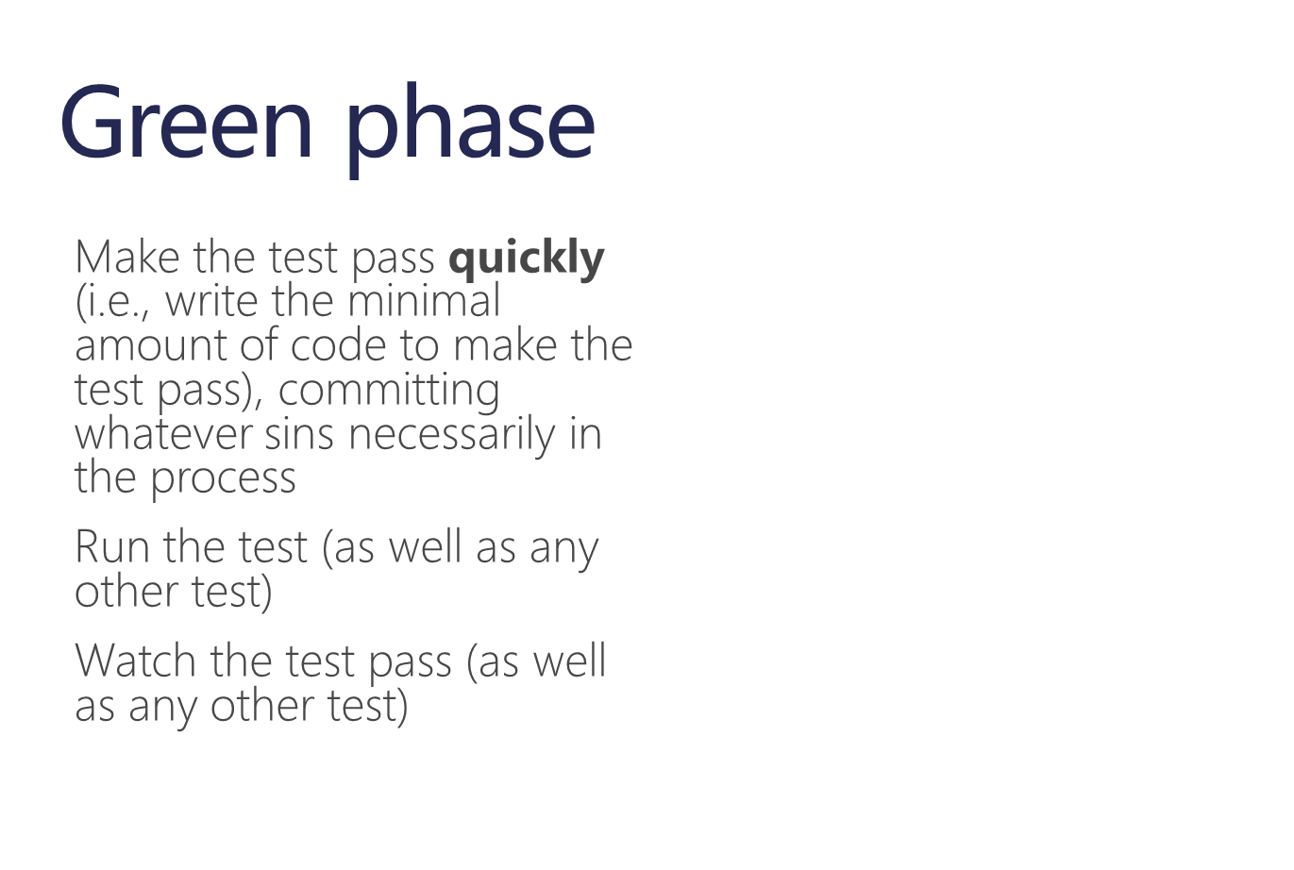


TDD in action – cycle #1
Use a FAKE response to make the test pass quickly (if possible)

Slide 27
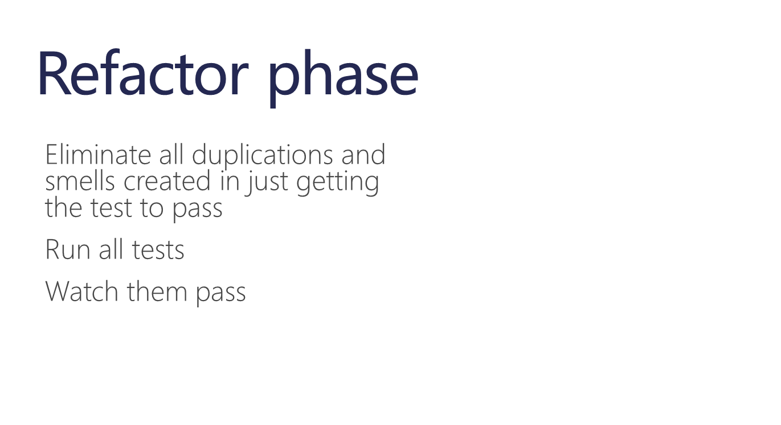
TDD in action – cycle #1
No refactoring opportunities? Ok, I am allowed to skip the refactor phase

Slide 28
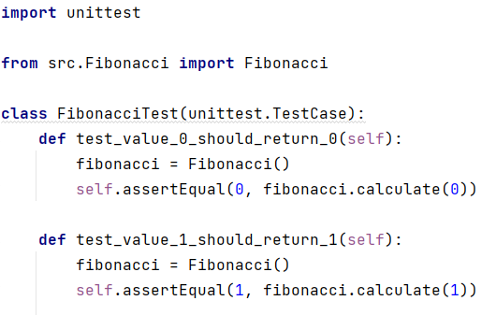
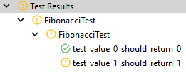
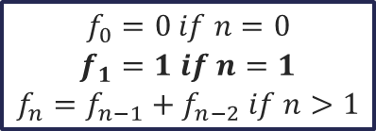
TDD in action – cycle #2
Chunk of functionality #2

Slide 29

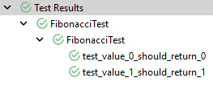
TDD in action – cycle #2
Replace the fake response with an ABSTRACTION for the considered behaviors

Slide 30
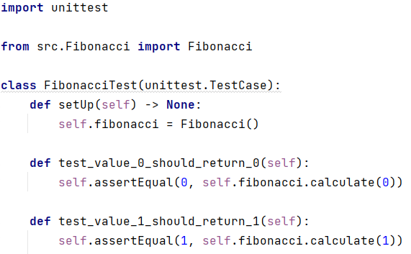
TDD in action – cycle #2
Test code is code! Refactor it!

Slide 31
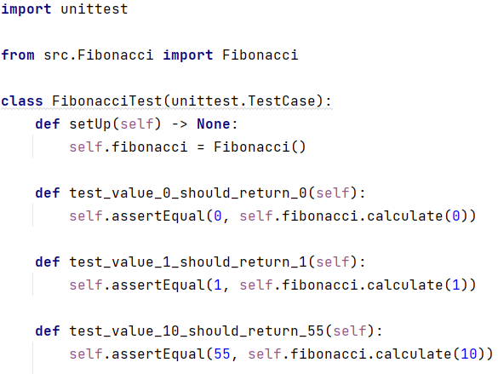
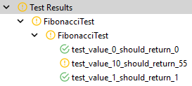
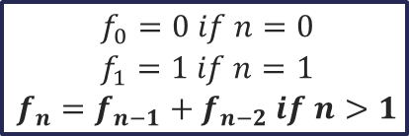
TDD in action – cycle #3
Chunk of functionality #3

Slide 32
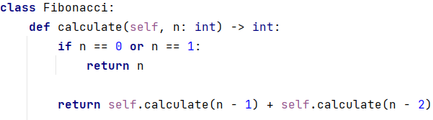
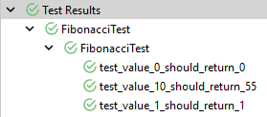
TDD in action – cycle #3
Are you still unsure about the correctness of your ABSTRACTION?
TRIANGULATION: add another test (e.g., check boundary conditions)!

Slide 33
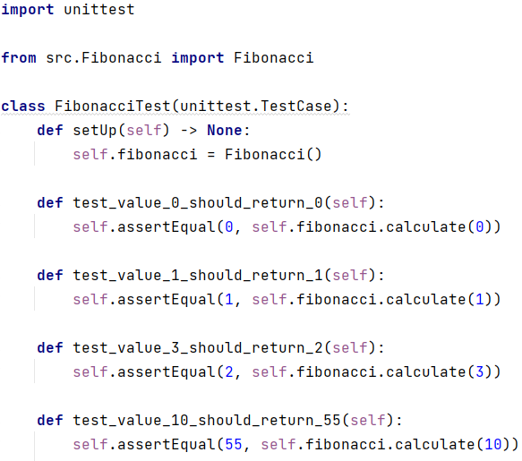
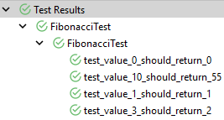
TDD in action – cycle #3
TRIAGULATION

Slide 34
TDD in action – cycle #3
No refactoring opportunities? Ok, I am allowed to skip the refactor phase

Slide 35

TDD benefits
Testable code
Problem understanding
Code coverage
Early fault detection
Regression testing
Simplified debugging
System documentation

Slide 36
TDD benefits
Testable code
It forces developers to write tests before the associated production code

Slide 37
TDD benefits
Problem understanding
It helps developers clarify their ideas of what a code segment is actually supposed to do because you have to first write a test for that segment

Slide 38
TDD benefits
Code coverage
Any code segment that you write should have at least one associated test, thus you can be confident that all the code in the system has been exercised

Slide 39
TDD benefits
Early fault detection
Code is tested as it is written so faults are discovered early in the development process

Slide 40
TDD benefits
Regression testing
A test suite is developed incrementally as a system is developed so regression tests ensure that changes to the system have not introduced new faults

Slide 41
TDD benefits
Simplified debugging
When a test fails, it should be obvious where the fault lies, namely the newly written code is the cause of that failure

Slide 42
TDD benefits
System documentation
The tests themselves act as a form of documentation that describe what the tested code should do, thus reading the tests can make it easier to understand the code

